Slide 1




Generalization Differences between End-to-End and Neuro-Symbolic Vision-Language Reasoning Systems
USC
Wang (Bill) Zhu
Jesse Thomason
Robin Jia
(Paper ID: 3109)

Slide 2
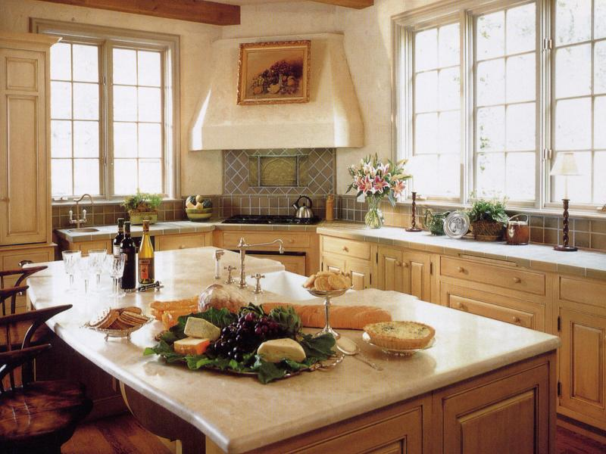
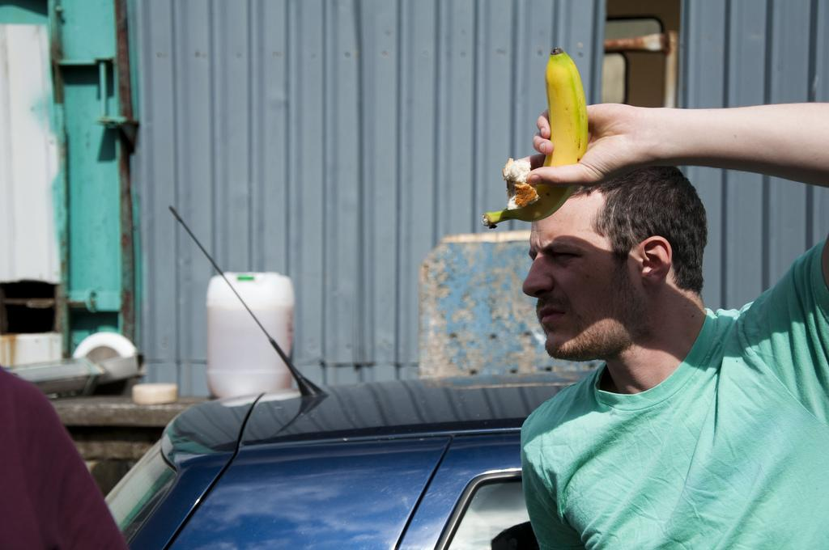
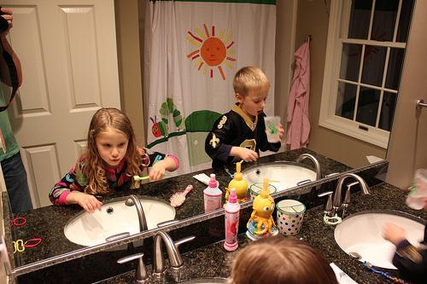
Problem Definition
Test Vision-Language End-to-End (VLE2E) models and Neuro-Symbolic (NS) systems on different OOD evaluation sets
Which paradigm is more robust?
Q: Is there at least 1 image with exactly 2 dark bottles on a counter.
Expected A: True
Evaluated Model
Acc: 88
Contrast Q: Is there less than 1 image with exactly 2 dark bottles on a counter.
Acc: ?
Expected A: False

Slide 3


Overall Findings
 | VLE2E | NS
In-distribution
Segment-combine test
Contrast sets
Compositional generalization
Cross-benchmark transfer

Slide 4
VLE2E Models on Multi-Image Setups
Q: There is at least 1 image …
CLS
Rep of the Question
Image 1 Question
Rep 1
2-layer Transformer
…
…
Pretrained VL Model
Classifier
Rep i
Q: There is at least 1 image …
Image i Question
Answer
A: True
(Bogin et. al. 2021)
Notes:
I’ll take COVR as an example to explain how to fine-tune pretrained models under the multi-image setup.

Slide 5
NS Models on Multi-Image Setups
Q: There is at least 1 image with exactly 2 dark bottles on a counter
attr: glass
bbox: [...]
bottle
Question
Scene graph generation
…
on
attr: marble
bbox: [...]
Semantic parsing
Scene graphs
Images
counter
Program
Execute
P: find(counter), find(bottle),
filter(dark, bottle), with_relation(on), group_by_images(), count_eq(2), geq(1)
Answer
A: True

Slide 6
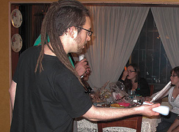
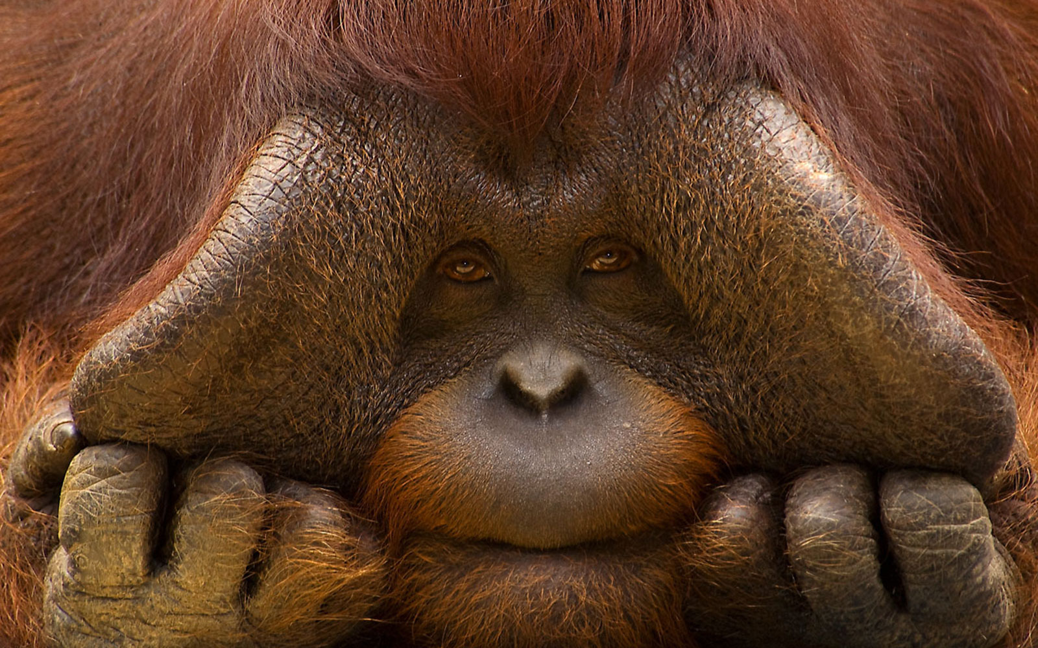
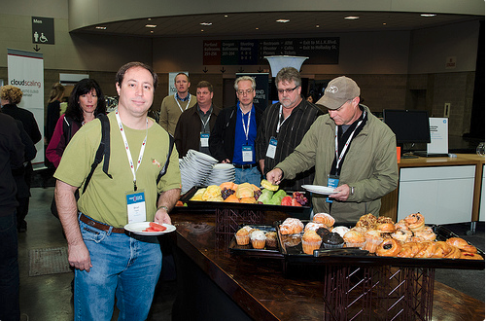
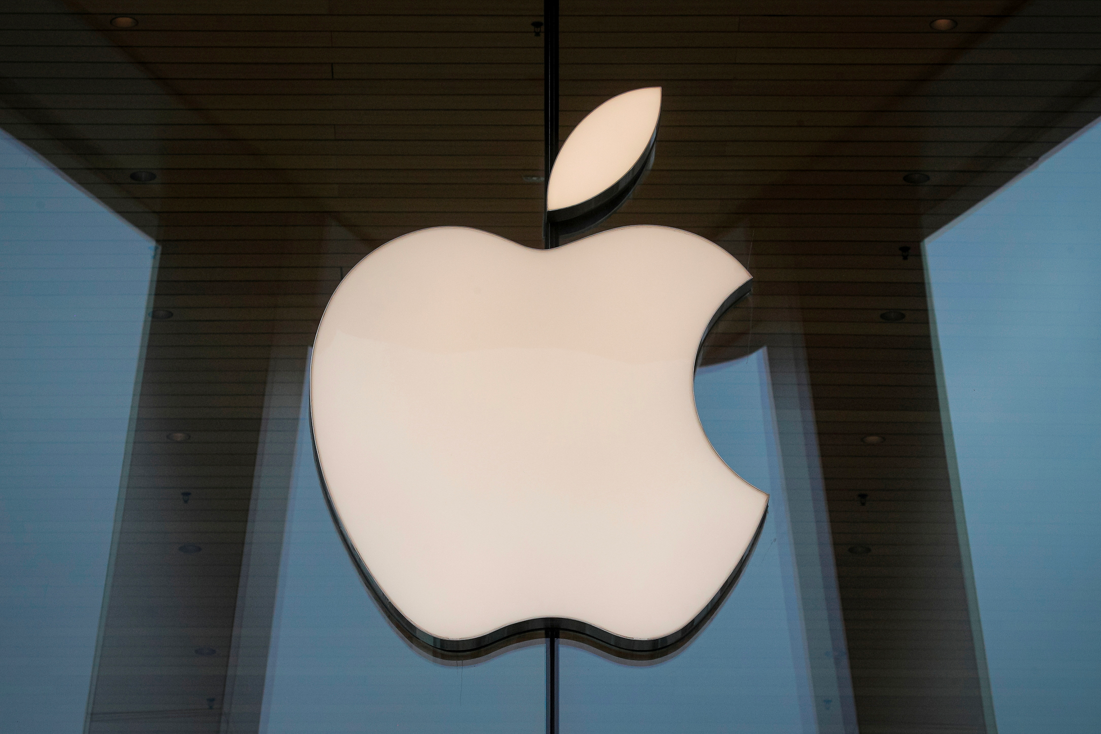
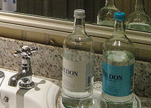
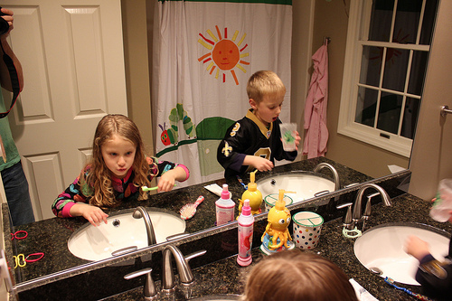
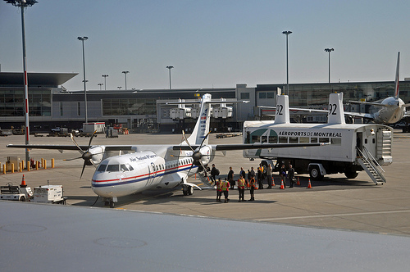
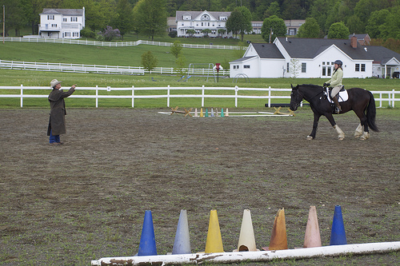
Evaluation 1 - Segment-Combine Test
Given a multi-image query on n images
Make n queries, each with 1 original image and n-1 unrelated images
Aggregate the results from step 2
Pred: No
Q: There is at least 1 image with exactly 2 dark bottles on the table
Pred: No
Pred: No
Pred: Yes
Label: Yes
Aggregated Pred: No
Or

Slide 7
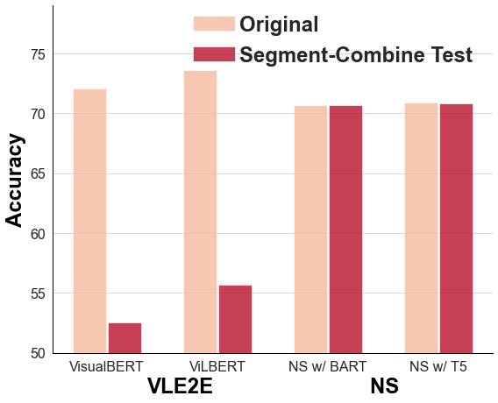
Evaluation 1 - Segment-Combine Test
VLE2E models are close to random guess on binary questions.
NS errors almost entire from scene graph parsing; semantic parse is accurate.
 | VLE2E | NS
Segment-combine test

Slide 8
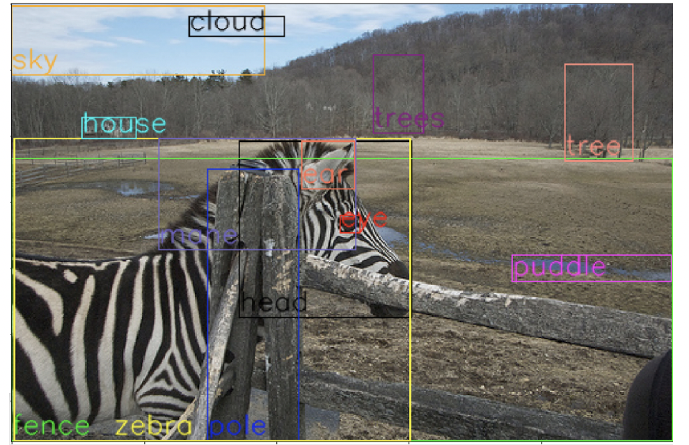
Evaluation 2 - Contrast Set
Bitton et al. (2021) created contrast set on GQA
Templated data augmentation based on scene graphs
Test the object-grounding ability
Original Q: Is there a fence near the puddle? | Label: Yes | Pred: Yes
Aug. Q #1: Is there a wall near the puddle? | Label: No | Pred: Yes
Aug. Q #2: Is there an elephant near the puddle? | Label: No | Pred: No

Slide 9
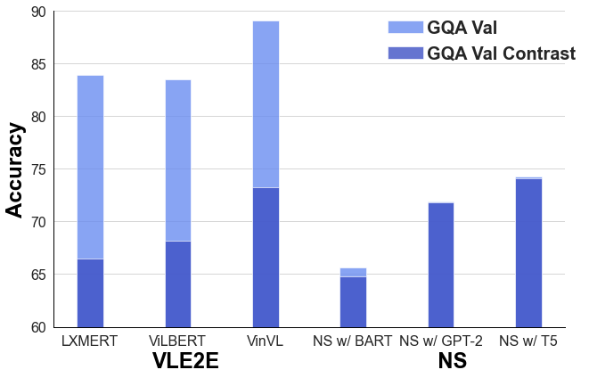
Evaluation 2 - Contrast Set
NS is lower on in-distribution
VLE2E models show weak object grounding.

Slide 10
Evaluation 2 - Contrast Set
Evaluate cross-image reasonings
Replace phrases in testing with phrases of equivalent meanings
At least → No less than
Replace phrases in testing with phrases of opposite meanings
At least → Less than & flip the label
Original Q: There is at least 1 cup that is behind a man that… | Label: Yes | Pred: Yes
Aug. Q #1: There is no less than 1 cup that is behind a man that… | Label: Yes | Pred: Yes
Aug. Q #2: There is less than 1 cup that is behind a man that… | Label: No | Pred: Yes

Slide 11
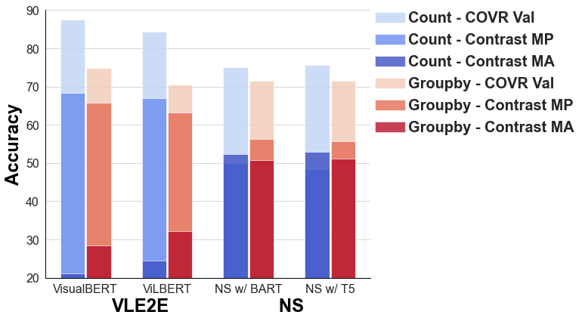
Evaluation 2 - Contrast Set
VLE2E models suffer on meaning-altering perturbations.
 | VLE2E | NS
Segment-combine test
Contrast sets
Notes:
Our hypothesis is VLE2E systems cannot generalize well to logical operations that are rare in the fine-tuning data:
The opposites of at least rarely or never appear in the training data, whereas the opposites of no and some are common.
At→less than, 96% of the predictions are the same.
The VLE2E systems do not pay enough attention to quantifiers whose opposites were not seen during fine-tuning.

Slide 12
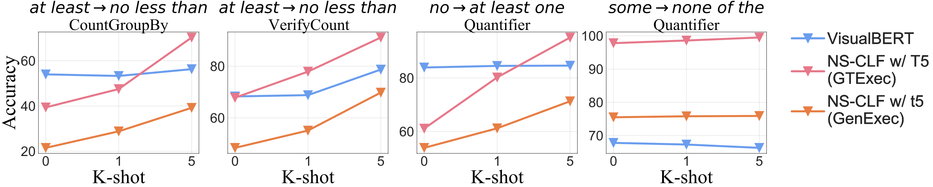
Evaluation 2 - Contrast Set
NS recovers quickly with few-shot training.

Slide 13
Evaluation 3 – Comp Gen (Language)
To unseen template
To unseen property
Hold out the examples when multiple properties co-occur
Leave examples when only a single property occurs
Test name | Training | Generalization
HAS-QUANT-COMPSCOPE & HAS-QUANT-ALL | No man that is next to a horse is standing All birds are black | All computer mice that are on a mouse pad are black
HAS-COUNT & HAS-ATTR | There are 3 dogs What is the black dog holding | There are 3 black dogs

Slide 14
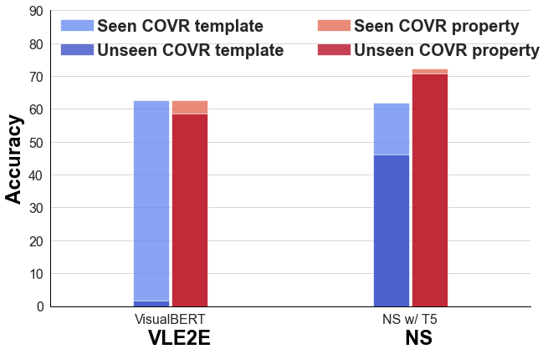
Evaluation 3 – Compositional Generalization
NS has higher compositional generalization performance.
 | VLE2E | NS
Segment-combine test
Contrast sets
Comp generalization

Slide 15
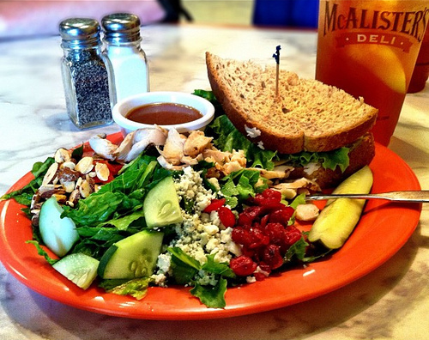
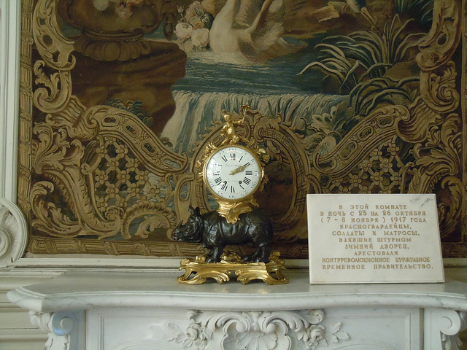
Evaluation 4 – Cross-Benchmark Transfer
Train (GQA): In which part of the image is the bottle?
Evaluate (VQA): Is there a mirror in the room?
Notes:
GQA is templated. VQA is human annotated.

Slide 16
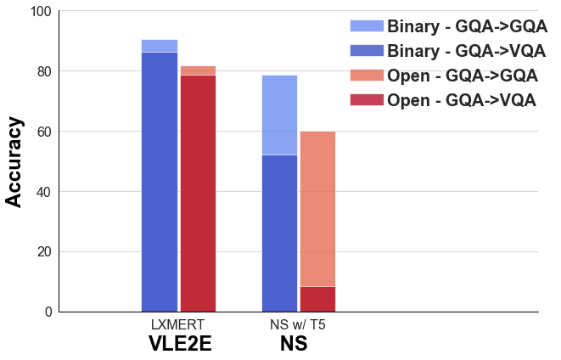

Evaluation 4 – Cross-Benchmark Transfer
From GQA to VQA, VLE2E is more transferable than NS.
 | VLE2E | NS
Segment-combine test
Contrast sets
Comp generalization
Cross-benchmark

Slide 17
Takeaways
 | VLE2E | NS
In-distribution
Segment-combine test
Contrast sets
Compositional generalization
Cross-benchmark transfer
Thank you for watching!
For more details, please refer to our paper or contact wangzhu@usc.edu
Our code is publicly available at https://github.com/Bill1235813/gendiff_vlsys

